Slide 1
INF10025
Data Management and Analytics
Lecture 9 – Part 3
Multi-Valued Attributes
Characteristic Entities
ERD Case Studies
Views
Visio

Slide 2
Views
Storing Complex SQL Statements

Slide 3
Views
When discussing SQL views, think back to MS Access
  creating and storing queries in MS Access.
  You simply double clicked on a saved query name and
  it retrieved data from tables.
A view is way to store a complex SQL Select command
and give it a name
Imagine this complex SQL statement:
SELECT e.empno, e.empname, e.deptid, b.bname
FROM EMPLOYEE e
INNER JOIN BRANCH b
ON e.bno = b.bno;
Suppose you could give the SQL statement a name: EmpView
Now, use that name in another SQL statement
  SELECT *
  FROM EMPVIEW ;

Slide 4
Views
A view is the storage of an SQL statement.
A view does not store data
A view requires very little disk space
even though using the view may select millions of rows
A view is often referred to as a virtual table.
  It looks like a table
  It behaves like a table
  It is not a table. It is simply a block of SQL code.
The rows in the result set generated by the view are not saved.
Each time the view is referenced, the SQL code in the view is executed.

Slide 5
Views
A view behaves just like a table
  Select columns from a view
  Use Where clause
  Use Join to link other tables and/or views
The view can now be treated like any table name
  SELECT *
  FROM EMPVIEW ;
  SELECT empname, bname
  FROM EMPVIEW
  WHERE empno = 15;
  SELECT e.empname, d.deptname
  FROM EMPVIEW e
  INNER JOIN DEPARTMENT d
  ON e.deptid = d.deptid;
simple select
some columns
some rows
joined with
other tables

Slide 6
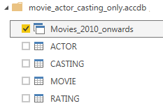
View of an Aggregation Query
Another example of a view based on a complex Aggregation Query
CREATE VIEW EMPAVG AS
SELECT d.deptname, Avg(e.Salary) "Average Salary"
FROM EMPLOYEE e,
  INNER JOIN DEPARTMENT d
  ON e.deptid = d.deptid;
GROUP BY d.deptname
HAVING Avg(e.Salary) >= 50000
The above code is hard to learn & time consuming to type.
Using a view in SQL is easier to type
          SELECT *
          FROM EMPAVG
Select a view name when importing data into power BI

Slide 7
Views & security
Imagine we have table Employee. It has a mixture of private & public data
  Some data should be queried by anyone
    (staffno, staffname, office_no, phone_no…)
  Some data should be queried only by management staff
    (salary, annual_leave_days, home_phone_no…)
  Some data should only be updated by Payroll staff
    (salary, annual_leave_days)
StaffNo | StaffName | OfficeNo | PhoneNo | Salary | AnnualLeave | HomePhone
ANYONE | ANYONE | ANYONE | ANYONE
 |  |  |  | MGMT | MGMT | MGMT
 |  |  |  | PAYROLL | PAYROL

Slide 8
Views & security
Create Multiple views
  Emp_Anyone_View (green columns from previous slide)
  Emp_Mgr_View (Employee_Anyone_View + blue columns …)
  Emp_Payroll_View (Emp_Mgr_View + red columns)
Database Administrators can create groups.
Every staff member is a member of one or more groups
  Deny Read / Write access of Employee table to anyone
  Grant Read access to Employee_AllUser_View for AllUsers
  Grant Read access to Employee_Mgr_View to Mgr group
  Grant Read / Write access to Emp_Payroll_View to Payroll group
  Finally
    allocate all staff to AllUsers group
    allocate management staff to Mgr group
    allocate payroll staff to Payroll group

Slide 9
Read Only View
A simple way to create a read only view is to add the clause:
    With Read Only
  to a CREATE VIEW statement.
    CREATE VIEW EmpView AS
    SELECT empId, empName, emPhoneNo
    FROM employee
    WITH READ ONLY;
  If a user attempts to delete rows from the employee table via EmpView
  DELETE FROM EmpView
  Then:
    Error at line 1:
    ORA-42399: cannot perform a DML operation on a read-only view

Slide 10
Views – Warning regarding updating tables
It is possible to
  Insert rows into a view (actually rows are inserted into
  the table the view is based on)
  Update rows in a view (ditto)
Care is needed
  A table may have constraints on some columns where that column
  is not in the view
  Example. This table specifies valid values for student gender
  Student Table
  StuId number Primary Key,
  StuName varchar(100),
  Gender varchar(1)
  CONSTRAINT check_gender CHECK ( Gender IN ('M', 'F', 'I') ) …

Slide 11
Updateable & Insertable Views
Create a view based on the Student table
  CREATE VIEW STUVIEW
  SELECT STUID, STUNAME FROM STUDENT
Create an insert statement based on the view
  INSERT INTO STUVIEW (stuid, stuname) values (100, 'Sue Davis');
  Such a statement would fail.
  The gender value (not supplied) does not meet the constraint
Similar problem(s):
  Inserting data into a View based on joined tables also needs careful thought and implementation. Tricky!
  Search the topic "Updatable and Insertable Views " for more info…
This semester, we will avoid the Updatable and Insertable view topic

Slide 12
Visio
Drawing ERDs the quick way…

Slide 13
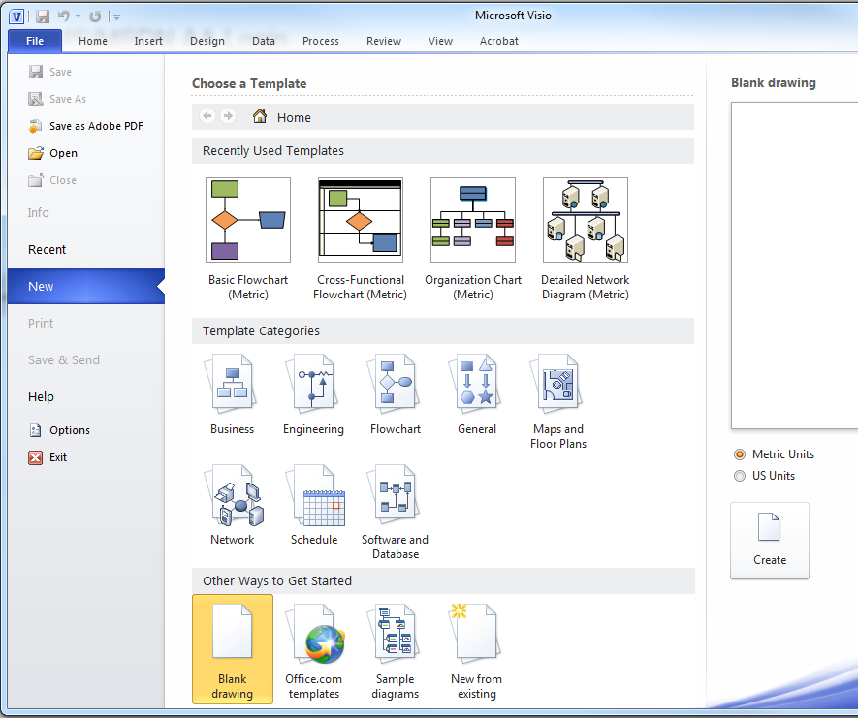
Visio – The Quick Way
Microsoft Visio is a drawing package – good for ERDs
Visio is installed on Lab PCs
It is available (plus other software) via Apps on Demand
To make a good looking ERDs in
Visio you only need to know
a few steps:
I suggest using the
Blank Drawing template
AVOID templates for ERDs or
Software and Database

Slide 14
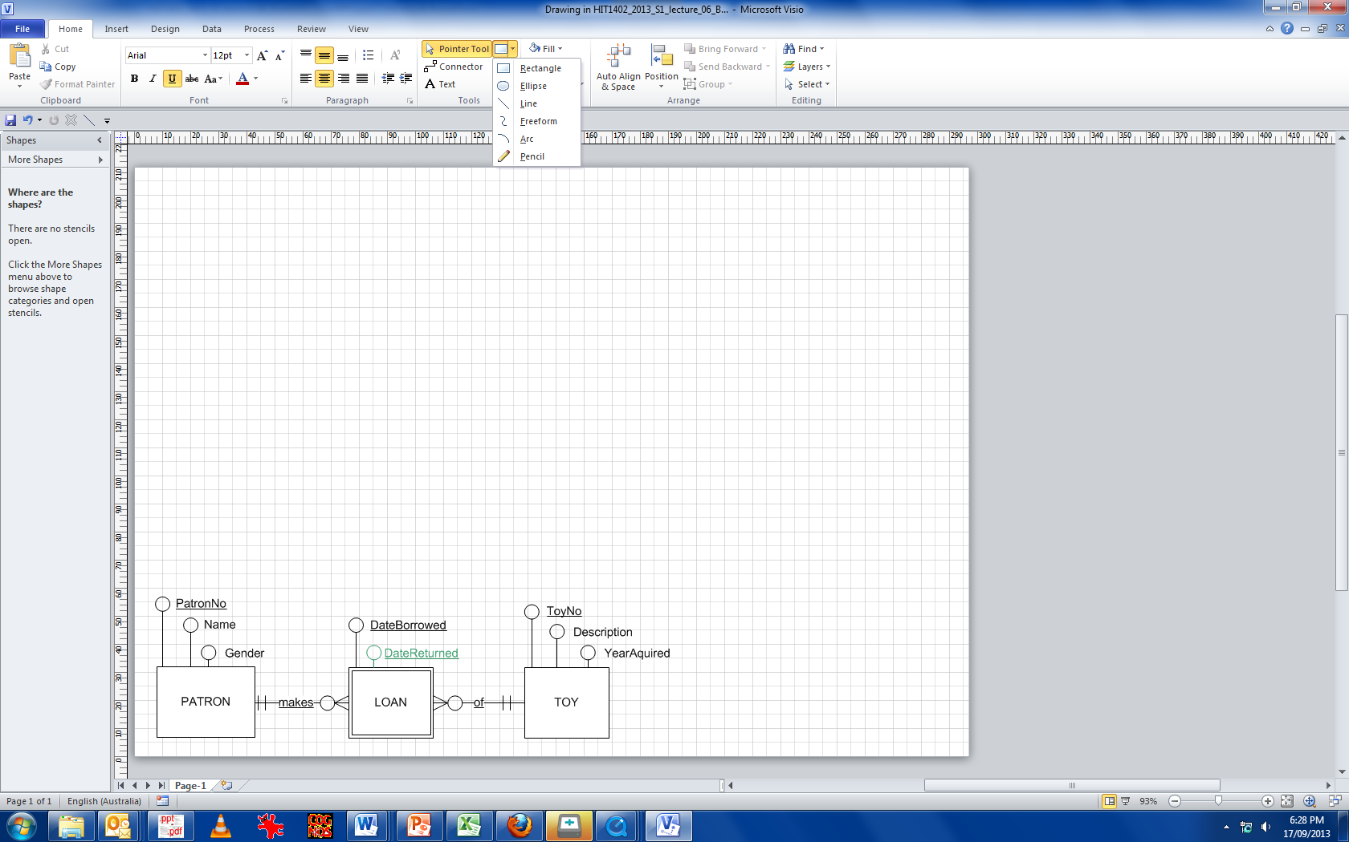
Visio – The Quick Way
To make a simple & good looking ERD in Visio you only need to know
a few steps:
The only drawing tools that
are required can be accessed
via the rectangle icon on the
ribbon.
Hint: If you know how to add
those drawing icons to your
customised access toolbar,
then it makes drawing a bit
faster.

Slide 15
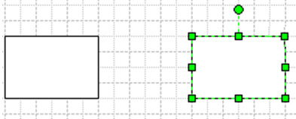
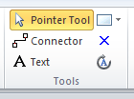
Visio – The Quick Way
Click the rectangle tool
and draw a rectangle
To stop drawing rectangles (or any shape)
click the pointer tool on the Ribbon

Slide 16
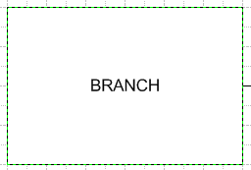


Visio – The Quick Way
Double Click rectangle to add text
Click the line tool to draw a relationship line
(Draw the line. If the line seems to draw itself at a slight angle,
hold the shift key down as your draw)
Double Click the line to
add text (e.g. 'has')

Slide 17
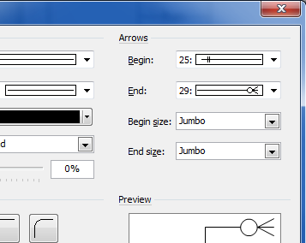
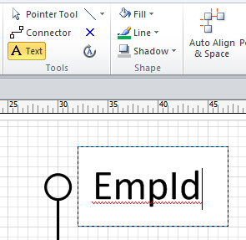
Visio – The Quick Way
To change the ends of the line:
Choose Format / Line from menu or
click the line and press Shift F3
    The most common line ends
    are 25 & 29.
    Use 20 for Attributes
    Use Jumbo for size
Use the Text Tool to add the attribute name.
Also useful for adding text underneath lines
has

Slide 18
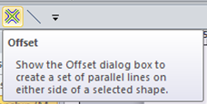
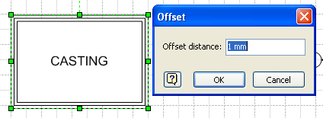
Visio – The Quick Way
Double Borders. One
way to create a double
border is to click on the
offset icon *
Then type 1mm
  This creates a triple outline. The outside box is highlighted.
  Press Del key to remove the outside (3rd) box.

Slide 19
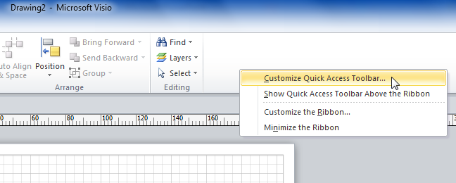
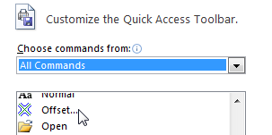
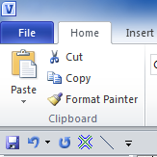
Visio – The Quick Way
  Note: The offset icon is not visible via standard menus in Visio!!!
  So do the following…:
  Click in the Grey Area of the
  Ribbon and choose
Customize Quick Access Toolbar
  Select All Commands
  Find the Offset option
  Click ADD so its added to the toolbar

Slide 20
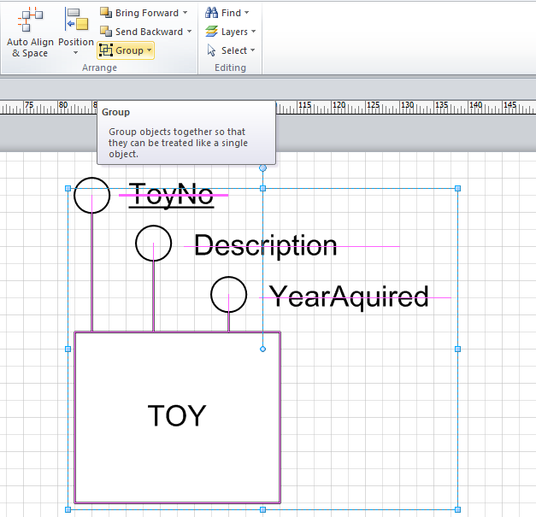
Visio – The Quick Way
Use the Group tool to glue objects together. They can then be 'moved as one'. Choose UnGroup to edit objects individually.

Slide 21
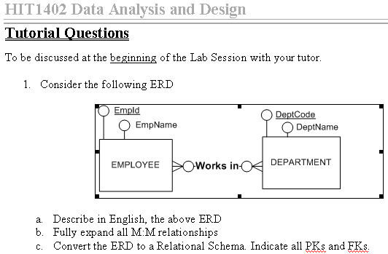
Visio – The Quick Way
To copy the entire ERD Drawing to MS Word:
  Save your work as a Visio drawing (for backup purposes)
  Select All
  Copy
  Open MS Word
  Paste
  The image can be resized etc.
Right Click the image to edit / open the drawing
  Visio must be installed on the computer to open / edit
That's it. Every ERD in INF10025 has used this method.

Slide 22
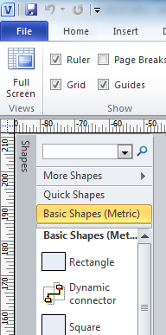
Visio – Using Intelligent Shapes
Visio drawings can also use 'intelligent' shapes.
  An intelligent shape uses connection points to connect shapes
  When one shape moves, all connected shapes adjust accordingly
  Choose View / Task Panes / Shapes / Basic Shapes
  Place rectangle shape on the drawing
  Use dynamic connectors to join the shapes
The list of shapes in this window may be in a different sequence. You can drag favourite shapes to the top of the list.

Slide 23
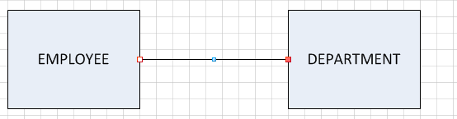
Visio – Using Intelligent Shapes
Two rectangle have been drawn.
Now use the Dynamic connector tool
to draw a line between shapes
The line snaps to one a the connection point on both shapes
Either shape can now be moved
The connection lines are auto-magically redrawn
Press Shift F3 to change the line ends for cardinality & participation constraints

Slide 24
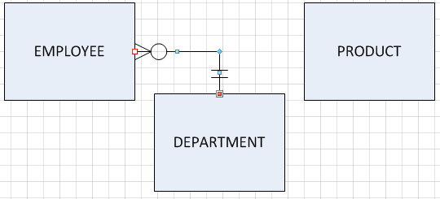
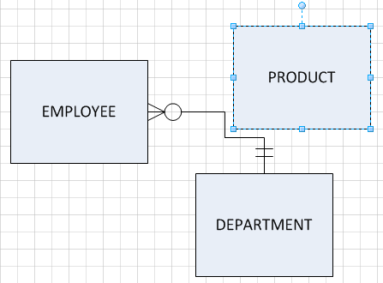
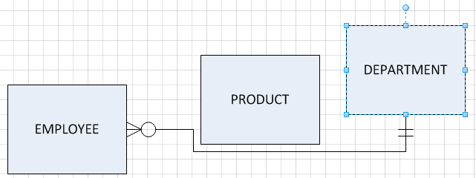
Visio – Using Intelligent Shapes
  Image 1 shows a dynamic connector drawn between Employee and Department.
  Image 2 shows how the connector is reshaped as the Product entity is dragged across the diagram
  Image 3 shows how the connector is reshaped again as the Department
  entity is dragged to a new location

Slide 25

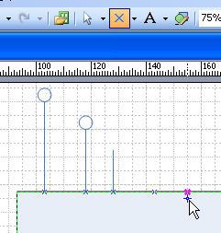

Visio – Using Intelligent Shapes
  Some rectangles may require
  many connection points
  (for attributes)
  Click on the Connection Tool icon
  and select the Connection Point
  Tool
  Hold down the Ctrl Key, and click
  on the edge of the rectangle.
  Each click creates a new
  connection point
https://support.office.com/en-au/article/Connect-shapes-by-using-AutoConnect-or-the-Connector-tool-6122a82b-8c1b-4965-b6e1-b15d26f8aab6

